Slide 1
Analysis of Variance (ANOVA)
Team 4 - Avery McNamee, Nasiba Radjabova, David Hogarth, Tyler Crist

Slide 2
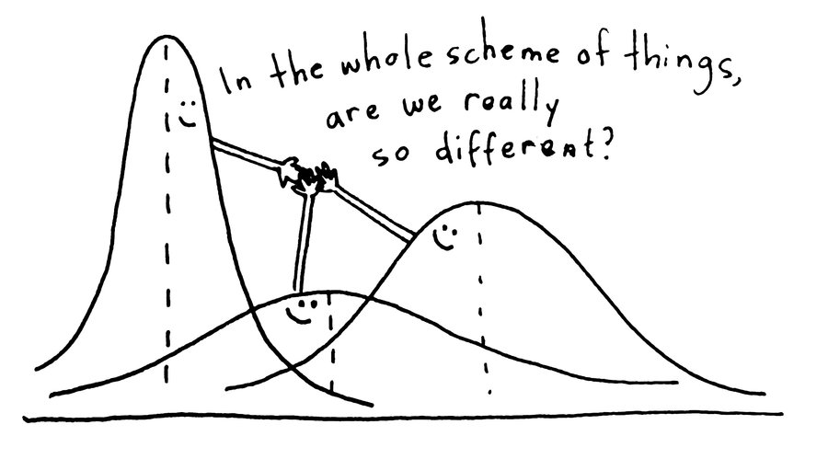
Agenda
ANOVA Introduction
How it works
Interpretation
Example exercise in RStudio
Kahoot!

Slide 3
What is ANOVA?
History of Anova
ANOVA → Analysis of Variance
A comparison of two statistical models.
One of these models is the full model (alternative hypothesis)
The other model is a simpler model that is missing one or more of the terms that the full model includes (null hypothesis)
​
​

Slide 4
How ANOVA Works
Full Model (M1): Y ~ A + B + C + D
Null Model (M0): Y ~ A + B
MS = SS/df
We obtain our F-statistic by contrasting the MS value associated with “the thing we’re interested in” (the model) with the MS value associated with “everything else” (the residuals)
We want to calculate the SS value that is associated with the difference between the two models
SS_{T} = SS_{M} + SS_{R}
Rearranging this: SS_{M} = SS_{T} - SS_{R}
SS_{M0} = SS_{T} - SS_{R0}
SS_{M1} = SS_{T} - SS_{R1}
SS_{Δ}=SS_{M1}−SS_{M0}=(SS_{T}−SS_{R1})−(SS_{T}−SS_{R0})=SS_{R0}−SS_{R1}
Notes:
The null model only contains some subset of the terms in the full model
**we want to see if adding the terms C & D improve our model!
Significant output – we reject the null in favor of the “full model!” – this is essentially the purpose of an ANOVA test

Slide 5



How ANOVA Works, cont.
MS for the difference between models:
MS for the residuals associated with the full model:
F-statistic:
Notes:
Full model is denoted by R1

Slide 6
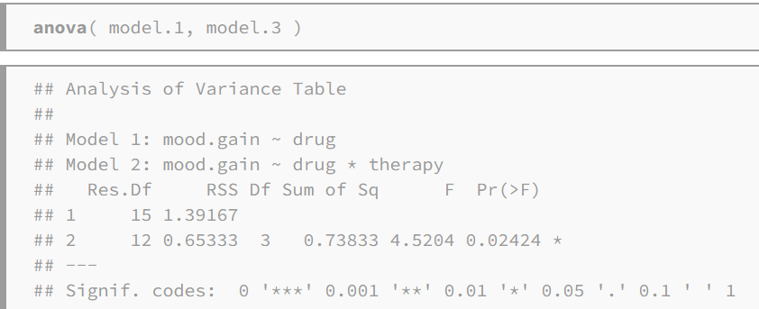
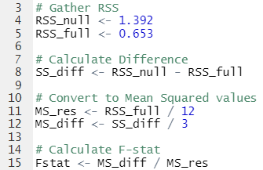
Calculating F-stat: An Exercise in R
F-test and degrees of freedom guide us to our p-value
Significant p-value → reject the null hypothesis
Notes:
Output looks a little similar to that of an lm()
The process on the right is using the formulas from the previous slide

Slide 7
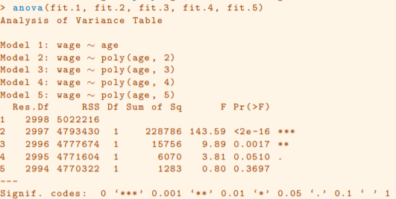
Interpreting ANOVA Output
Notes:
When we reject the null, we say that the second model is better than the first one (put in earlier slide)
Nearly identical to the recent codio exercise - ANOVA with polynomial regression

Slide 8
Kahoot!

Slide 9
References
https://stats.libretexts.org/Bookshelves/Applied_Statistics/Book%3A_Learning_Statistics_with_R_-_A_tutorial_for_Psychology_Students_and_other_Beginners_(Navarro)/16%3A_Factorial_ANOVA/16.05%3A_The___F___test_as_a_model_comparison
https://hastie.su.domains/ISLR2/ISLRv2_website.pdf

